Slide 1
Lunch & Learn
Enterprise könnten Social sein.
Präsentiert: Raymond Gao
September, 2012

Slide 2
das Bier, die Wurst, und die Brezel
What are in common between Food and Computing?
What is Good food?
Ask ten people, you get ten different answers.
Tasty, Wholesome, Looks and Smells nice, Nutritious, facilitates good conversation, …
What is Good Enterprise IT architecture?
Purposeful, efficient, easy to manage, positive ROI, …
A lot of good IT people are also Foodies!
Notes:
http://backroadjournal.wordpress.com/2011/10/26/a-foodies-tour-of-munich/

Slide 3
Who is this Speaker?

Slide 4
Wer ist Ray? (Who is this dude?)
Job history
Authored Salesforce / Ruby Integration Toolkit
Chief Architect @ Nokia Business Infrastructure
Senior E-Commerce Architect / Technical Manager @ Sun Microsystems (now Oracle)
Board of Director for Project JXTA (P2P Computing - Bit Torrent)
Java Community Process Member
Publications
Editor-in-Chief, Peer-to-Peer Computing Journal (Peer-reviewed)
eAI Journal, Enterprise Linux, XML Journal, …
Conferences
JavaOne 2001
WebServices One 2002
Dagstuhl 2005 (Max Planck Institute)
University of Dresden
etc
Notes:
Avant, j’ai travaillé chez:
Sun Microsystems comme l’Architecte Principal pour Commerce Électronique (Senior E-commerce Architect)
Nokia comme l’Architecte Principal pour les Régions Amériques du Nord et Sud (Chief Program Architect)
Le Membre de l’Organisation JCP, pour la but d’avancer la technologie Java comme une software libre (JCP Board Member)
Le Membre du Conseil du Projet JXTA, une plate-forme libre pour la Connexion Pair à Pair (Peer-to-Peer Computing) – (JXTA Board of director)
Le Rédacteur en Chef pour le P2P Journal (Une revue de la technologie Pair à Pair qui était jugée par les membres)
J’ai donné présentations dans les congres:
Java One
Java Plus
Le Séminaire Dagstuhl, qui était organisée par L’institut Max Planck et Le Société de l’Informatique Allemande (Max Planck Institute & Deutusche Informatik Gesellschaft)
Etc.
J’ai publié les articles dans les revues:
Enterprise Linux,
XML Journal,
eAI Journal,
etc/.

Slide 5
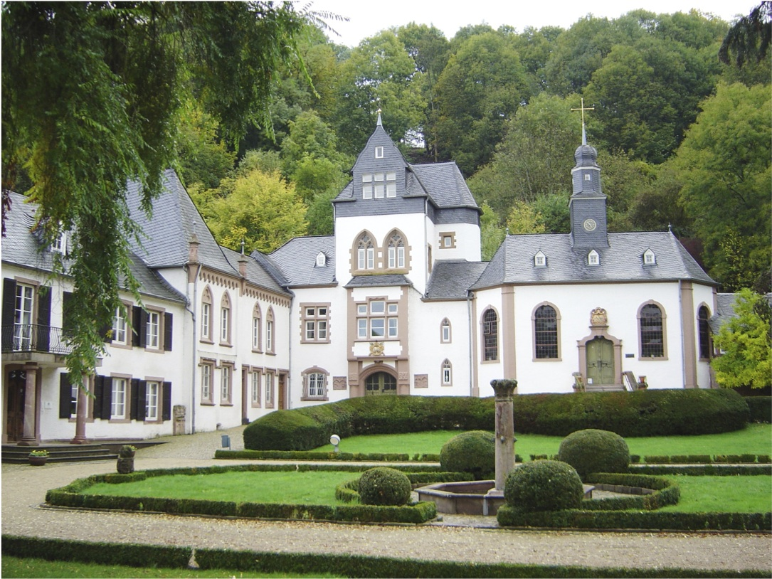
Dagstuhl, Saarland, 2005

Slide 6
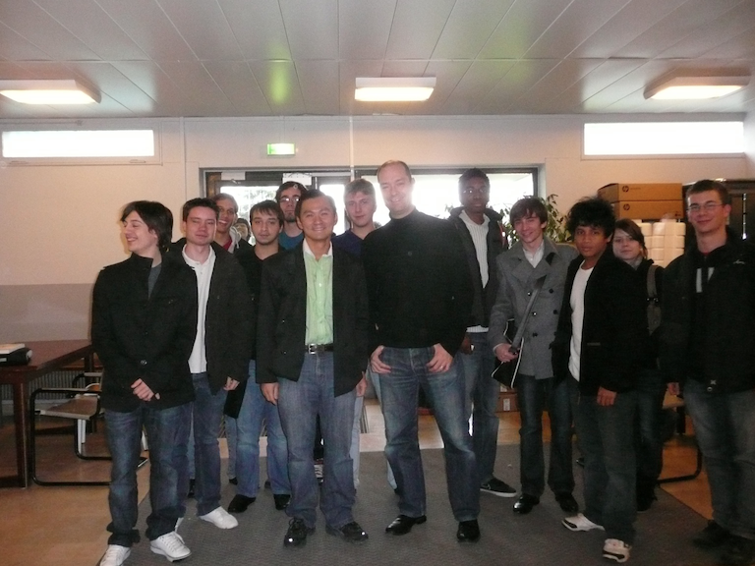
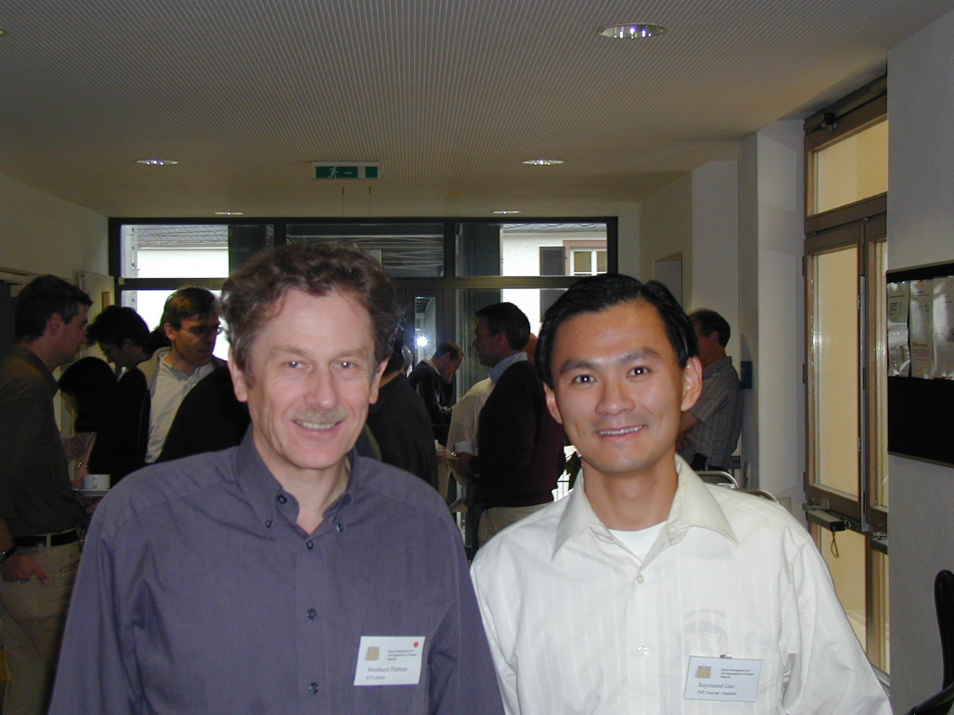
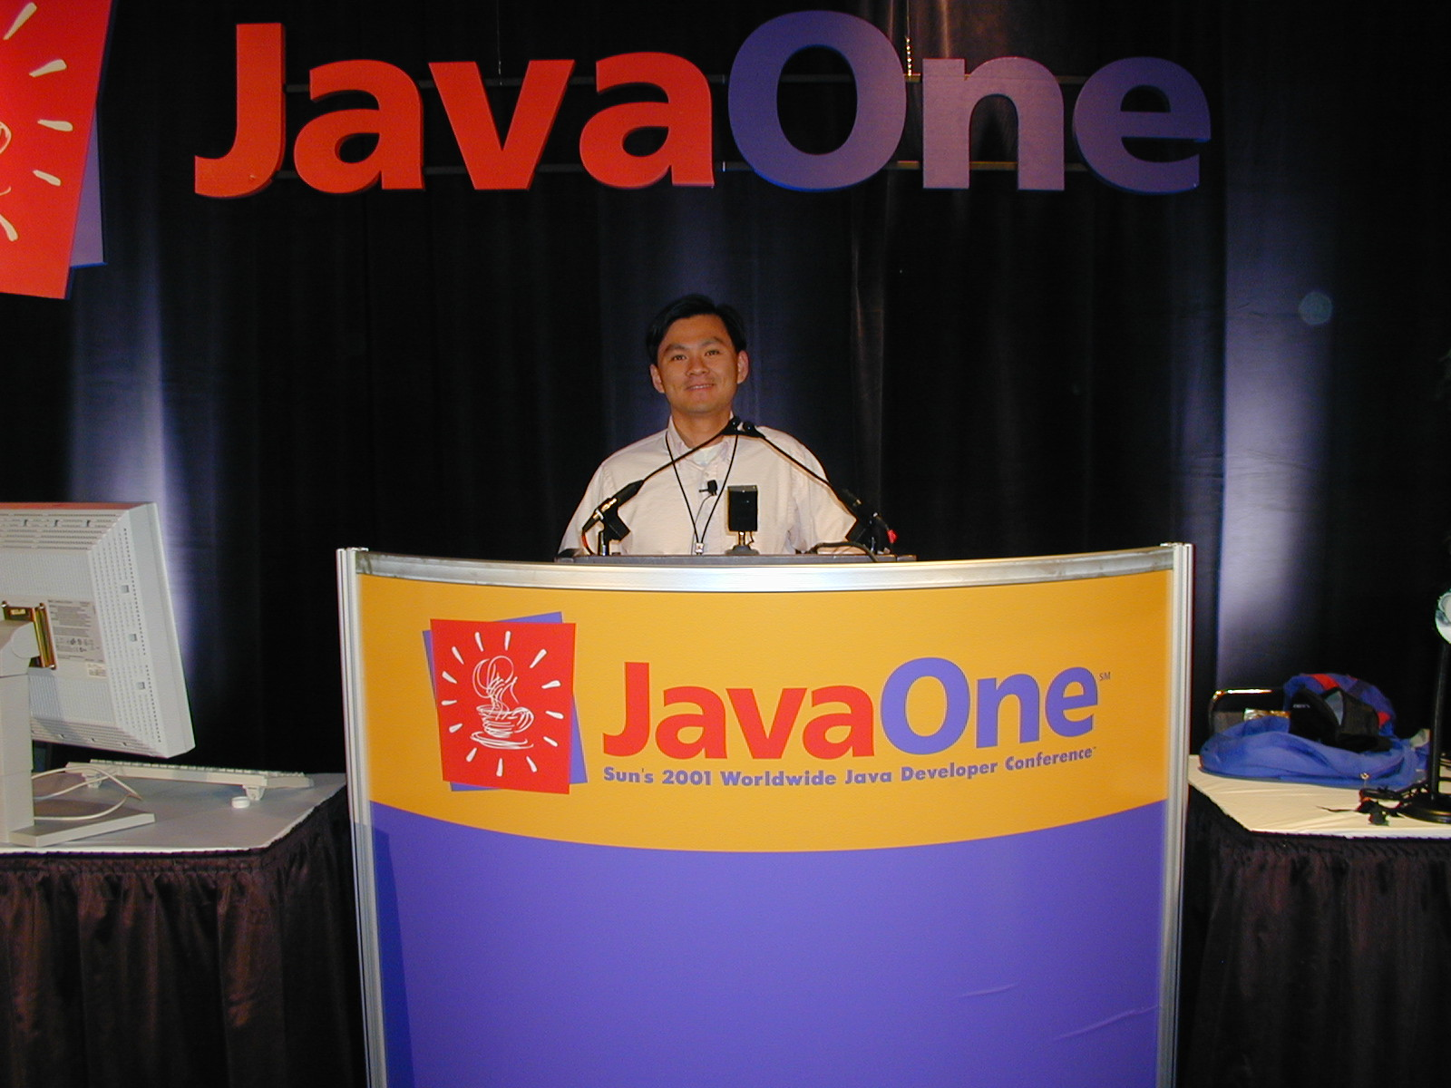
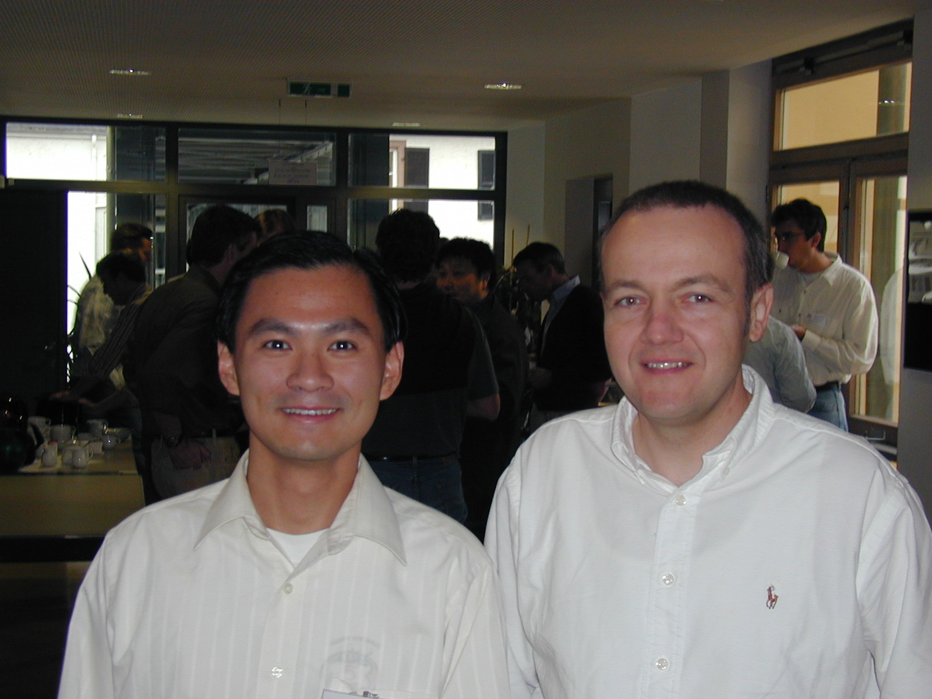
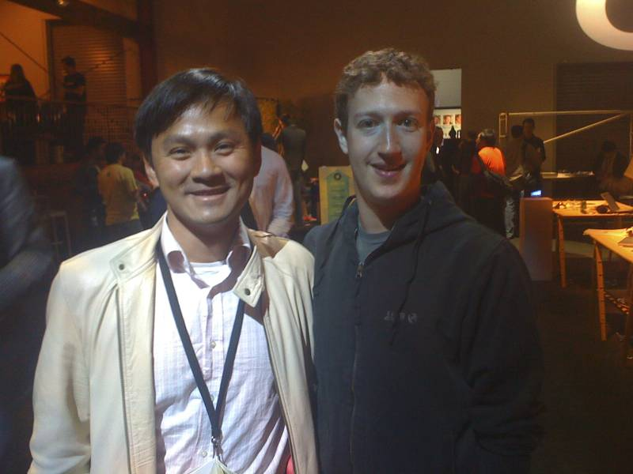
Photos from my past conference
University of Burgundy
France, 2010
Dagstuhl, 2005
JavaOne
San Francisco, 2001
Dagstuhl, 2005
F8, 2009

Slide 7
Background Information

Slide 8
Ask My Audience
What do you do?
AEs / SEs / Architects / Developer?
What kinds of clients & customers do you have?
What do you think about doing business in Bavaria & Germany?
Challenges
Unique Situations
Trend

Slide 9
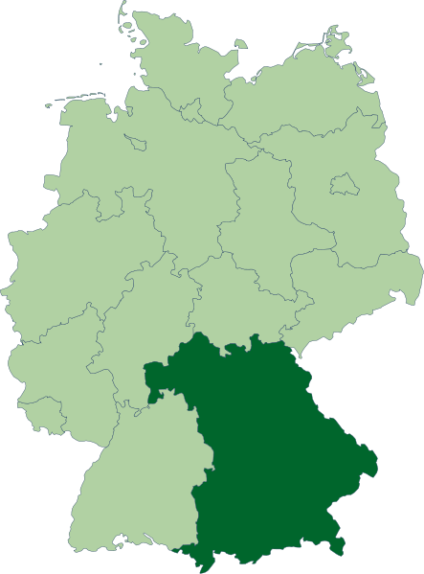








Business Climate in Bavaria
Notes:
Most are Manufacturing based.
Große Firmen in Bayern
Bayern verfügt über eine sehr starke Wirtschaft mit vielen guten Firmen, die interessante Arbeit bieten. Hier eine Auswahl von großen Firmen in Bayern, die vielfältige Arbeit anbieten:
BMW
Audi
MAN
Knorr-Bremse
Siemens
Nokia Siemens Networks
Infineon
Microsoft
ProSiebenSat1 Media
Sky Deutschland
Kabel Deutschland
Burda Verlag
EADS
Krauss-Maffei
Fujitsu Technology Solutions
KUKA
UPM-Kymmene
Verlagsgruppe Weltbild
Media-Saturn-Holding
Continental Automotive
Maschinenfabrik Reinhausen
Osram Opto Semiconductors

Slide 10
Different Industry Verticals Different Enterprise IT Requirements
Manufacturing – Inventory Management, Resource Planning, Demand Forecasting and Shipping, ERP
Life Science – Customer Care, Vendor Management
Software – Revenue Recognition, Sales & Marketing
Media – Lead-to-Cash, Reporting, BI Analytics
Distribution – Warehouse Management, Fulfillment, Partner Relation Management
Finance – Risk Management, CRM, Reporting, Billing

Slide 11
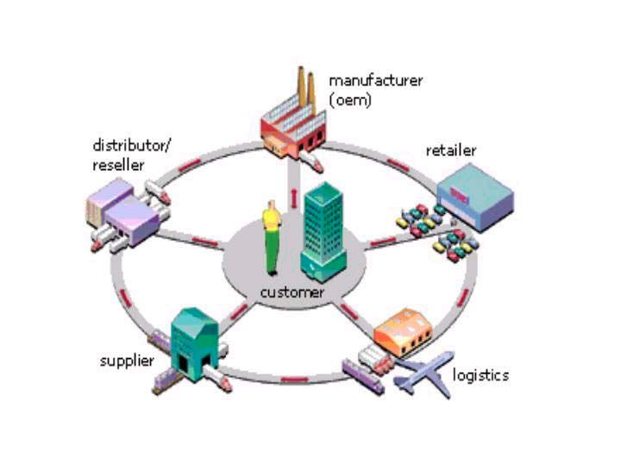
Business Overview

Slide 12
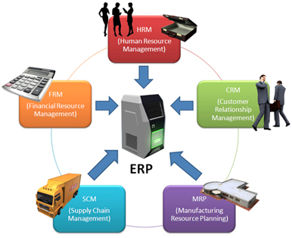
ERP in the Big Picture

Slide 13
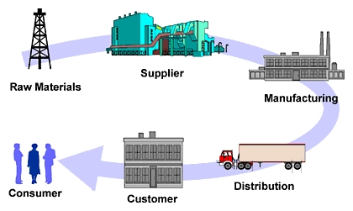
Manufacturing Process
Notes:
Inventory Control is a very important part of the process. Capital and Cash Flow.

Slide 14
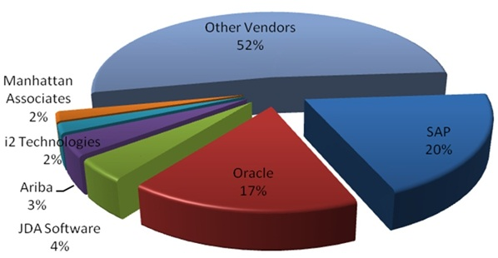
ERP Market Share
Notes:
SAP ERP 20 – 32%

Slide 15
Enterprise IT System – 3 NOTs
Too Complex
Too Bloated
Too Expensive
Notes:
Why ERP has a such bad name?

Slide 16

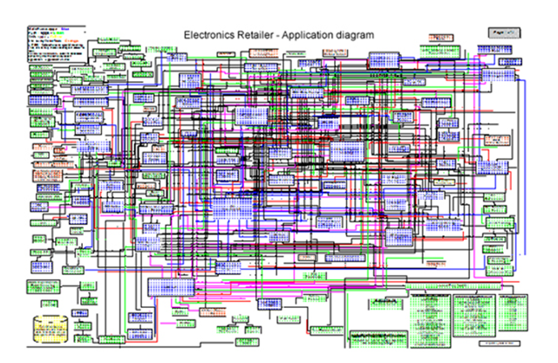
Big Bloat
Reasons:
Overly Technical
Too Complex
Boring,
Costly
Dangerous to your health

Slide 17
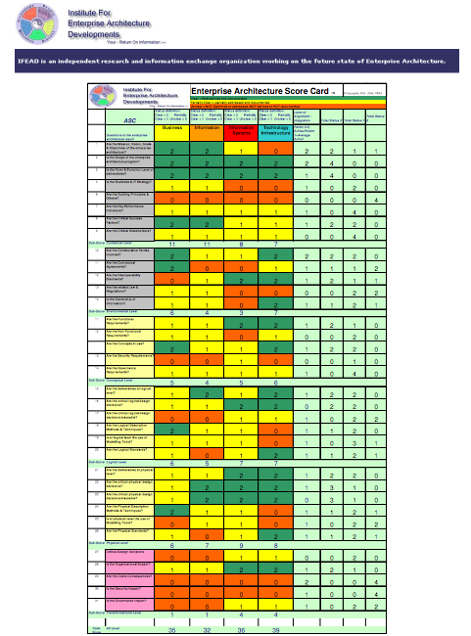
Unnecessary Complexity
Mistake x Mistake ≠ Success

Slide 18
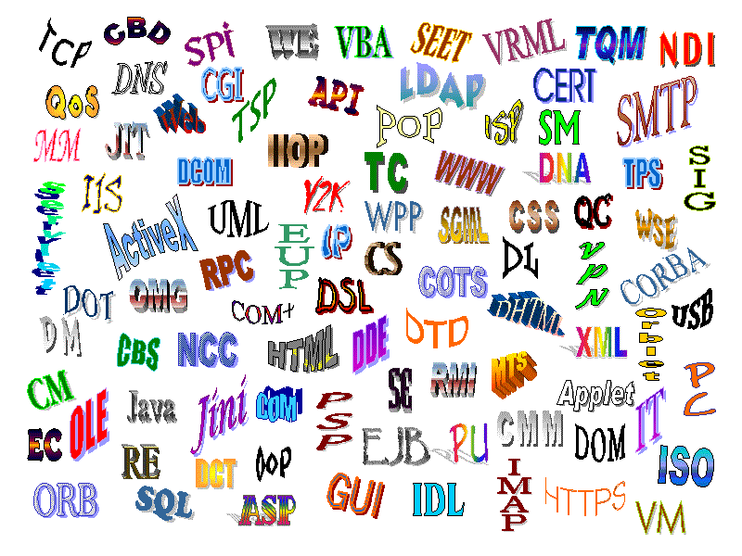

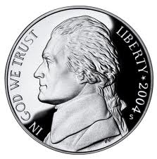
Acronym City
Only God understand this!!!
Notes:
Big budget does not mean fulfill everyone of the niches of the Acronym City

Slide 19
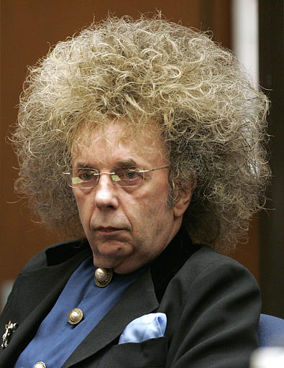
Is there a Salvation
from the
Bad Hair Day?

Slide 20
Keys to Good Design
Easy to understand
Clear Business Process
Good Use Case leads to positive ROI, lower TCO
Capital vs. Operating Cost
Preserves existing investment – Integration

Slide 21



Put it to Together

Slide 22
What are the main strength of Salesforce CRM system?
Robust Data Model & Processes
Well managed and timely system & API updates
Trust.Salesforce.com
API releases (Spring, Summer, Winter, …)
SaaS model leads to High Adoption Rate
Capital Expense -> Operating Expense
Notes:
Is this necessary??? Ask them

Slide 23
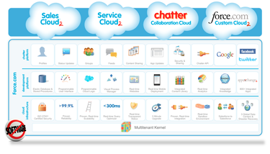
Think Salesforce, Think Integration
Notes:
https://help.salesforce.com/apex/HTViewHelpDoc?id=integrate_what_is_api.htm&language=en_US
http://blogs.developerforce.com/tech-pubs/2012/08/thinking-salesforce-think-integration.html?utm_source=feedburner&utm_medium=feed&utm_campaign=Feed%3A+SforceBlog+%28Force.com+Blog%29

Slide 24
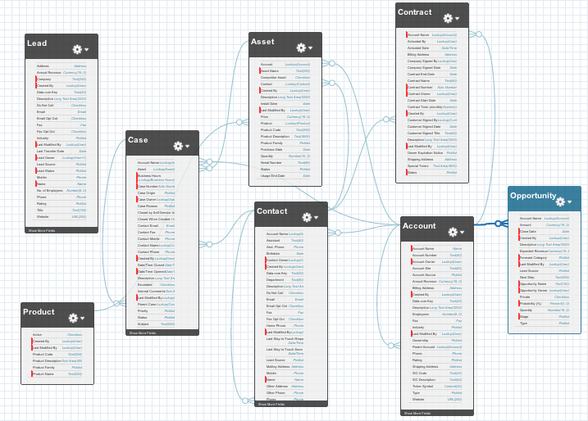
Robust Data Model

Slide 25

Changing Landscape of IT

Slide 26
Interesting New Development
Increasing importance of Dynamic Languages and Platforms
Ruby, Clojure, Play, Python, …
Rise of Big Data / NoSQL
MongoDB, Hbase, Cassandra, Redis, CouchDB, Dynamo DB
Social Coding
Github, StackOverflow, HotScripts, CoderWall, CodePlex, …

Slide 27
Leading Programming Platforms *
Java
Spring
JSF
.Net
C#
Dynamic Languages
J2EE
Ruby
Python
Perl
PHP
Functional (Scala / Clojure)
Node.JS
Struts 2
VB
Mac
Object C
AppleScript
For Enterprise IT
Notes:
Server side only,
Client side must also include Object C, Android Dalvik.

Slide 28
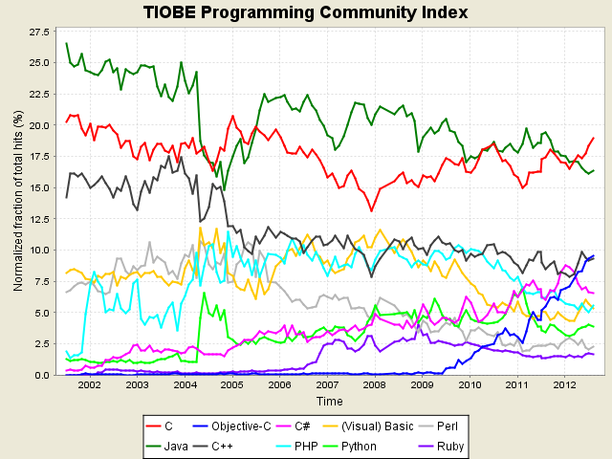
Programming Language Index

Slide 29
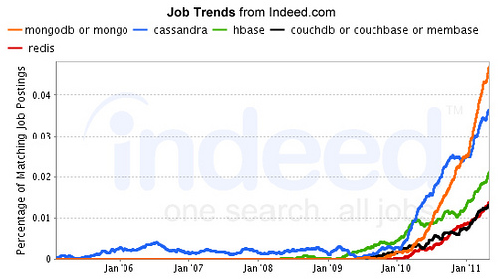
NOSQL Growth Rate

Slide 30
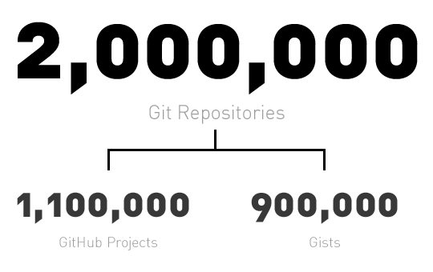
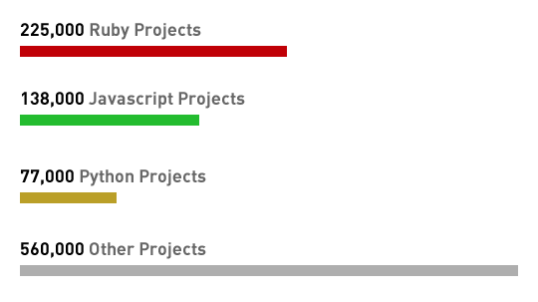
GitHub Stats – April 20, 2011
Notes:
https://github.com/blog/841-those-are-some-big-numbers
http://go.bloomberg.com/tech-deals/2012-07-09-github-takes-100m-in-largest-investment-by-andreessen-horowitz/
$100 Million investment from Marc Andreessen (4 year old company is worth $750 million)

Slide 31
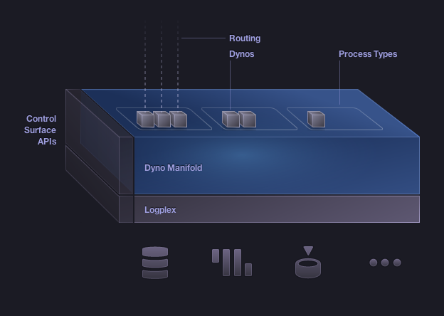
Sweet Spots for Heroku
Languages & Platform Support
Clojure
Java – Spring / Play
Python – Django
Scala
Facebook
Node.js
Ruby - Rails
Notes:
Polygot Platform & Eco-System, Need to talk about DatenSchutzen.

Slide 32

What is the deal with DatenSchutz?

Slide 33

Continuity of Business Process
Web 2.0 Portal
Salesforce CRM
Lead Generation
SEO
Cool UIs
Order Management
Reporting
Case Tracking
Chatter
Ruby / Heroku
ERP System
Inventory Management
Java AS (NetWeaver, Oracle Glassfish, …)
Production Scheduling
Supplier Management
Java Based Gateway

Slide 34
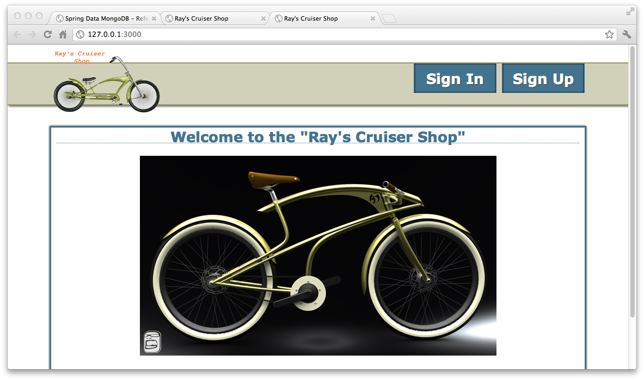
Front Portal on Heroku

Slide 35
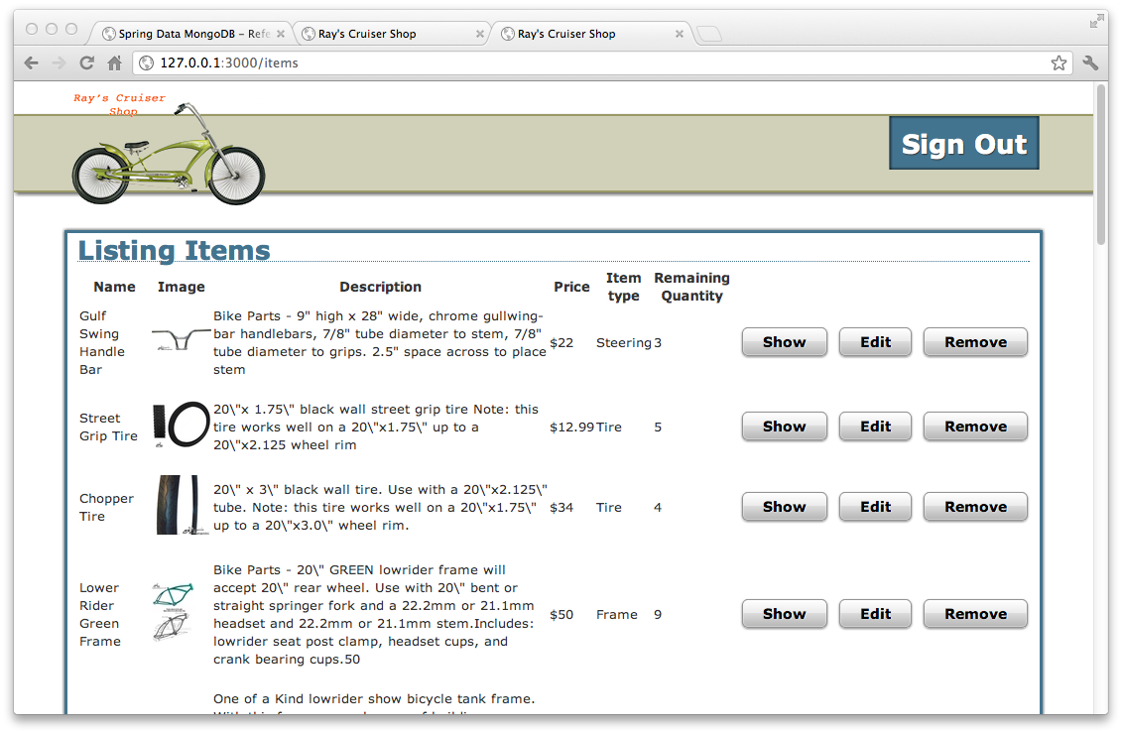
Inventory Management

Slide 36
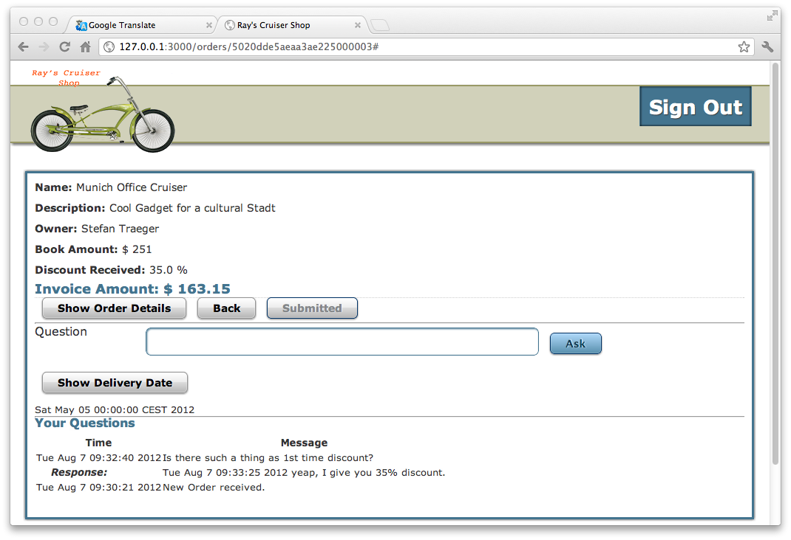
Order Overview

Slide 37
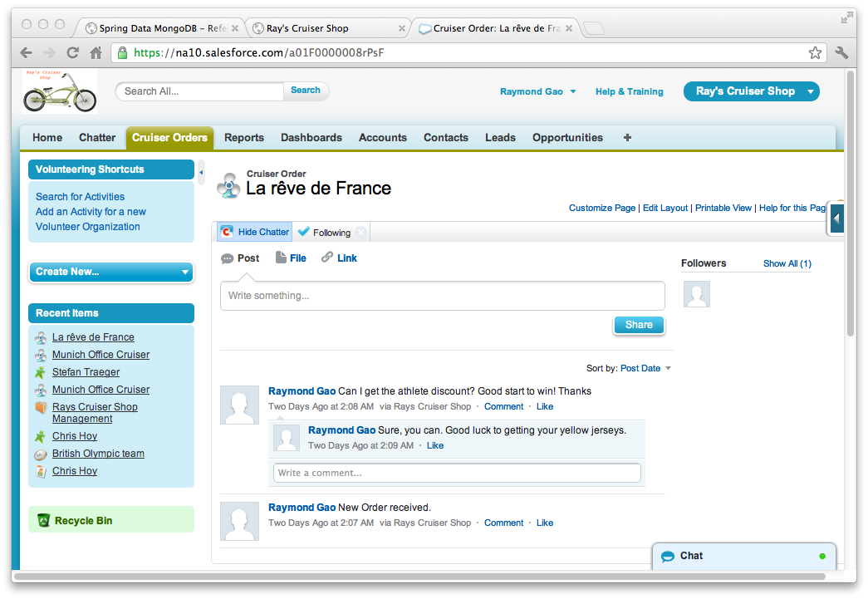
Order to Chatter

Slide 38
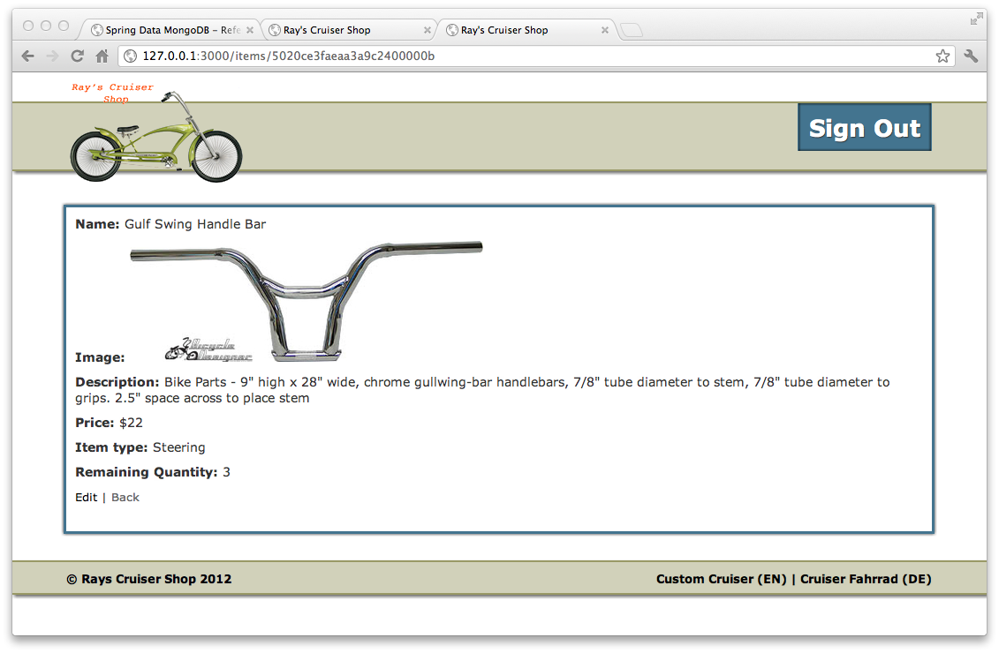
Part Details

Slide 39
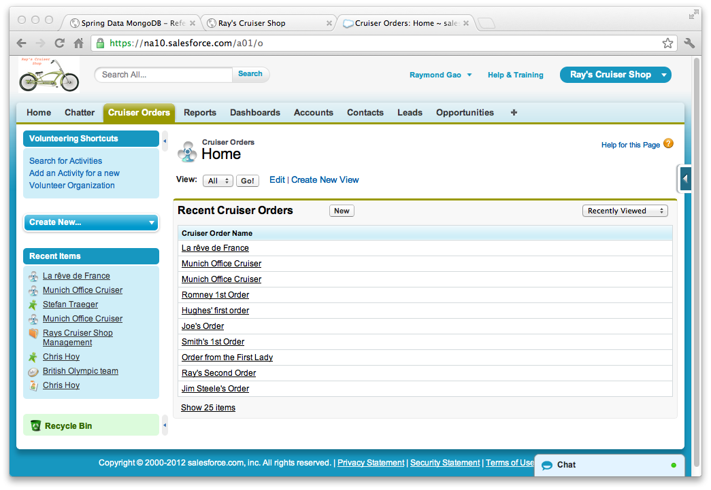
Portal to Salesforce Synch

Slide 40
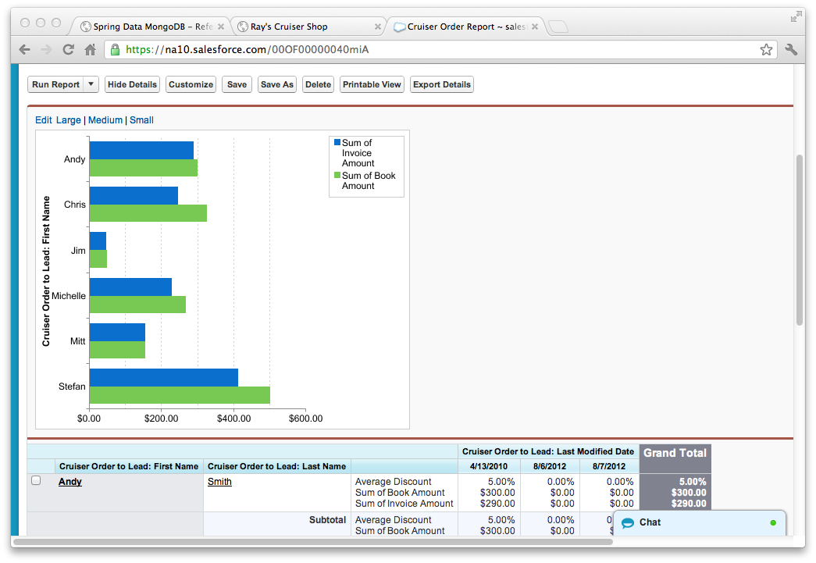
Salesforce Data Reporting

Slide 41
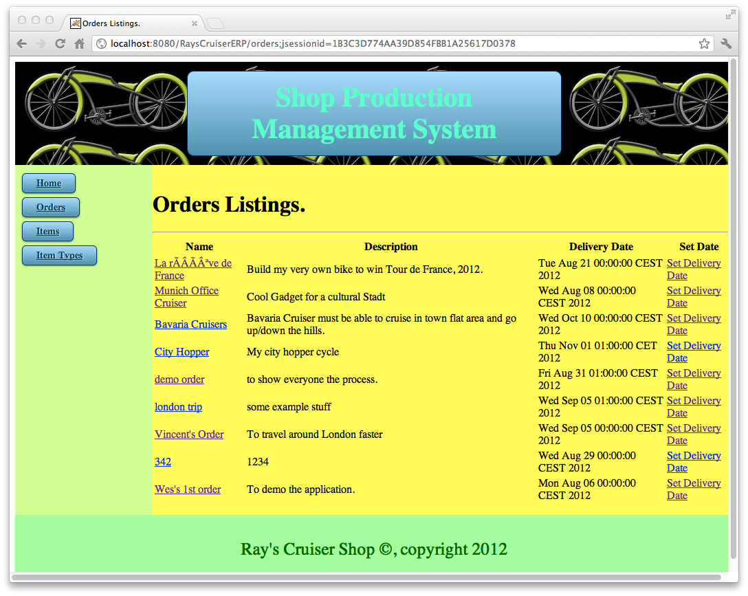
Backend ERP App (Java)

Slide 42
Technology & Timeline
Ruby - Custom portal
Custom Objects and Attributes – Salesforce CRM
Java Spring – Java App Server (Tomcat, Oracle Glassfish, SAP NetWeaver)
JSON / REST APIs
Time: ~3 Weeks
Building the environment – 10 Days
Setup Linux, Download IDE & Plugin, SAP installation & Configuration, DB administration, …
Development
Ruby App – 3 Days
Java App – 4 Days
Testing – 1 Day

Slide 43
Business Process Integration
Key Features & Benefits:
Perfect solution for DatenSchutz
Continuity of Business Processes vs. Data Moving
Preservation of Existing IT Investment
Social Enterprise all the way, including the Floor Workers
Production Scheduling & Inventory Management driven by Real-time Market-data.
Best of breed technology
Simple yet Robust architecture (extension of community data model)

Slide 44
Enterprise Architecture in 3 Simple Words
Strategy + Process + Vision => Huge Business Value
Put things together; and, they just work!

Slide 45
My Contact Info
Email: raymond@tquila.com
Twitter: raygao
Skype: raygao2000

Slide 46
Backup Slides

Slide 47
Show the Demo
Two screens, Custom portal & Salesforce side by side.
ERP

Slide 48
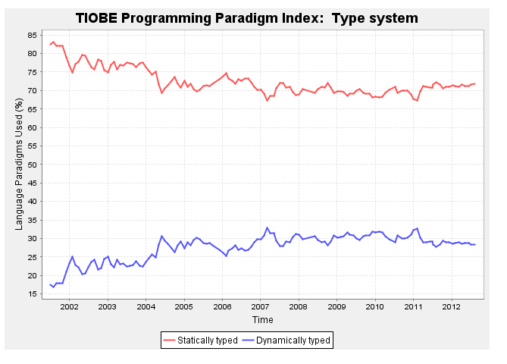

Slide 49
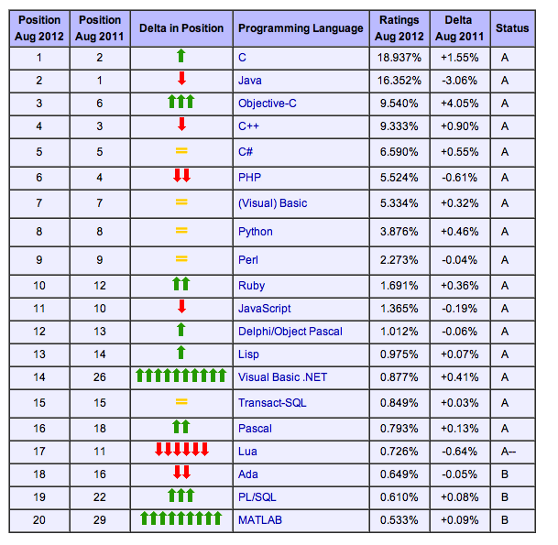
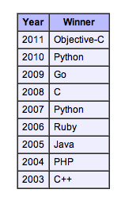
Top 20 Programming Languages

Slide 50
Integration between Ruby & Java
Java Side
/*show Order Delivery Date */
@RequestMapping(value="/show_delivery/{id}", method = RequestMethod.GET)
@ResponseBody public String show_delivery(@PathVariable("id") String id, Model model) {
Orders order = service.read(id);
logger.info("show order delivery date => " + order.getName());
model.addAttribute("order", order);
// return order; //This returns a Date in JSON format
return order.getDelivery_date().toString(); //This returns a Date in String format
}
Ruby Side
# Show Delivery date
def show_delivery
order_id = params[:order_id]
url = SiteConfig[:sap_server][:host] + ":" + SiteConfig[:sap_server][:port] + "/RaysCruiserERP/orders/show_delivery/" + order_id
# TODO change to use HTTParty
logger.info("url is #{url}")
response = HTTParty.get(url).body
render :text => response
end

Slide 51
JSON Example
{
"_id" : ObjectId( "5020ce4caeaa3a9c24000011" ),
"description" : "Bike Parts - Z2 STRETCH Cruiser frame with tank BLUE - will accept 24\\\" or 26\\\" rear wheel. Use a straight springer fork and a 22.2mm headset, or a 1\\\" steering tube chopper fork with a 1\\\" chopper headset.\\r\\nPart #: 514831”,
"image_filename" : "stretched_cruiser_frame.jpg”,
"item_type_id" : ObjectId( "5020ce3faeaa3a9c24000006" ),
"name" : "Stretched Cruiser Frame”,
"price" : 179,
"quantity" : 4,
"remaining_quantity" : 8
}

Slide 52
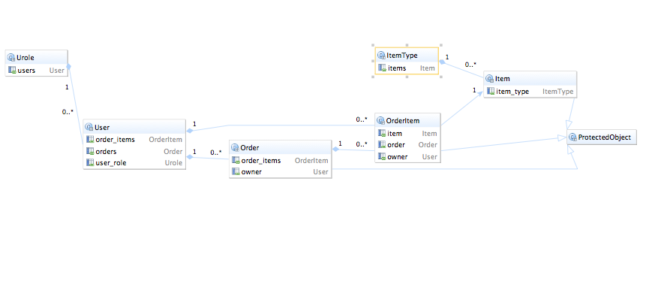
Application Data Model

Slide 53
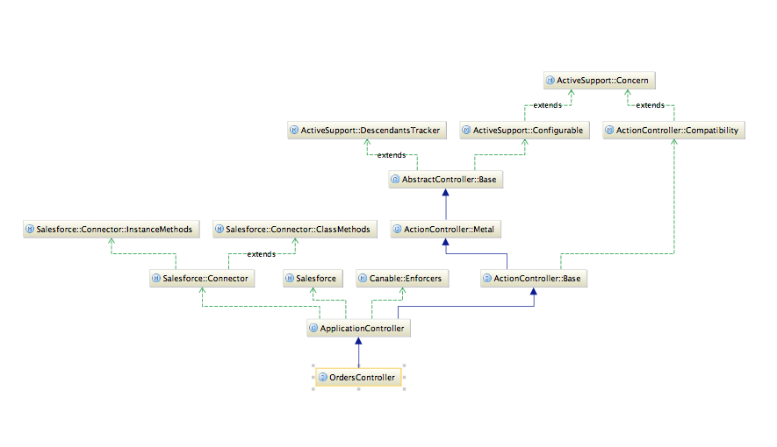
Application Class Diagram

